Slide 1
Transform and Conquer (Chapter-6)
Team – I Presentation (Solvi Magnusson, Ishan Anand, Rishi Tej Talluri)
Reference : Introduction to Design and Analysis of Algorithms, 3rd Edition by Anany Levitin
Note: All of the slides have been prepared according to the syllabus mentioned and no other topic has been covered except than that for the chapter.

Slide 2
1.0 Introduction
Many algorithmic problems are easier to solve if their input is sorted.
The Transform-and-Conquer strategy works as follows:
problem's
instance
simpler instance
or
another representation
or
another problem's instance
solution

Slide 3
2.0 Transform and Conquer
Either the problem or algorithm can be transformed in one of three ways:
The instances of the problem can be transformed into an easier instance to solve called Instance simplification
The data structure can be transformed so that it is more efficient called Representation change.
The problem can be transformed to an easier problem to solve called Problem reduction.

Slide 4
3.0 Presorting
Presorting is a common example of instance simplification. Presorting is sorting ahead of time, to make repetitive solutions faster.
interest in sorting algorithms is due, to a significant degree, to the fact that many questions about a list are easier to answer if the list is sorted.
The cost for determining uniqueness (without the sorting cost) is Θ(n).
The total cost is:
T(n) = Tsort(n) + Tscan(n) ε Θ(n log n) + Θ(n) = Θ(n log n)

Slide 5
3.1 Presorting Algorithm
Algorithm:
PresortMode(A[0...n-1])
// assumes that A is sorted
i ← 0
modefrequency ← 0
while i < n do
runlength ← 1
runvalue ← A[i]
while i+runlength < n and A[i+runlength] = runvalue do
runlength++
if runlength > modefequency then
modefrequency ← runlength
modevalue ← runvalue
return modevalue

Slide 6
4.0 Gaussian Elimination
There is a much more elegant algorithm for solving systems of linear equations called Gaussian elimination.
The idea of Gaussian elimination is to transform a system of n linear equations in n unknowns to an equivalent system with an upper-triangular coefficient matrix, a matrix with all zeros below its main diagonal.
we can solve linear equations system by general-izing the substitution method for solving systems of two linear equations.

Slide 7
4.0 Gaussian Elimination Contd.
The transformation is accomplished by a sequence of elementary operations on the system’s coefficient which is described as: for i ←1 to n-1 do replace each of the subsequent rows (i.e., rows i+1, …, n) by the difference between that row and an appropriate multiple of the i-th row to make the new coefficient in the i-th column of that row 0

Slide 8
4.0 Gaussian Elimination Contd. 2
elementary operations used for solving by Gaussian Elimination:
exchanging two equations of the system replacing
an equation with its non-zero multiple
replacing an equation with a sum or difference of this equation and some multiple of another equation
Since no elementary operation can change a solution to a system, any system that is obtained through a series of such operations will have the same solution as the original one.

Slide 9
5.0 Forward Elimination Algorithm
ForwardElimination(A[1..n, 1..n], b[1..n])
//Applies Gaussian elimination to matrix A of a system’s coefficients, //augmented with vector b of the system’s right-hand side values //Input: Matrix A[1..n, 1..n] and column-vector b[1..n]
//Output: An equivalent upper-triangular matrix in place of A with the //corresponding right-hand side values in the (n + 1)st column
for i ← 1 to n do A[i, n + 1] ← b[i] //augments the matrix for i ← 1 to n − 1 do
for j ← i + 1 to n do
for k ← i to n + 1 do
A[j, k] ← A[j, k] − A[i, k] ∗ A[j, i] / A[i, i]

Slide 10
6.0 Better Forward Elimination Algorithm
BetterForwardElimination(A[1..n, 1..n], b[1..n])
//Implements Gaussian elimination with partial pivoting //Input: Matrix A[1..n, 1..n] and column-vector b[1..n]
//Output: An equivalent upper-triangular matrix in place of A and the //corresponding right-hand side values in place of the (n + 1)st column for i ← 1 to n do A[i, n + 1] ← b[i] //appends b to A as the last column for i ← 1 to n − 1 do
pivot row ← i
for j ← i + 1 to n do
if |A[j, i]| > |A[pivot row, i]| pivot row ← j for k ← i to n + 1 do
swap(A[i, k], A[pivot row, k])
for j ← i + 1 to n do
temp ← A[j, i] / A[i, i]
for k ← i to n + 1 do
A[j, k] ← A[j, k] − A[i, k] ∗ temp

Slide 11
7.0 Balanced Search Tree
A balanced binary search tree is a tree that automatically keeps its height small (guaranteed to be logarithmic) for a sequence of insertions and deletions. This structure provide efficient implementations for abstract data structures such as associative arrays.
An AVL tree requires the difference between the heights of the left and right subtrees of every node never exceed.
Allowing more than one element in a node of a search tree. Specific cases of such trees are 2-3 trees, 2-3-4 trees, and more general and important B-trees.

Slide 12
7.0 Balanced Search Tree Contd.
Balanced Search trees
B Trees
AVL Trees
Two approaches of Balanced Search Trees are:

Slide 13
7.1 AVL Tree
AVL tree is a self-balancing Binary Search Tree (BST) where the difference between heights of left and right subtrees cannot be more than one for all nodes.
The height h of any AVL tree with n nodes satisfies the inequalities.
log2 n ≤h<1.4405 log2(n + 2) − 1.3277.

Slide 14
7.2 Two-Three Tree
A 2-3 tree is a tree that can have nodes of two kinds:
2-nodes
3-nodes
A 2-node contains a single key K and has two children.
A 3-node contains two ordered keys K1 and K2 (K1<K2) and has three children.
These lower and upper bounds on height h.
log3(n + 1) − 1≤ h ≤ log2(n + 1) − 1.

Slide 15
8.0 Heap
A heap is a binary tree with keys at its nodes (one key per node) such that:
It is essentially complete, i.e., all its levels are full except possibly the last level, where only some rightmost keys may be missing.
The key at each node is ≥ keys at its children (this is called a max-heap)
The heap is also the data structure that serves as a cornerstone of a theoretically important sorting algorithm called heapsort.
The key values in a heap are ordered top down; i.e., a sequence of values on any path from the root to a leaf is decreasing

Slide 16
8.1 Heap Sort
ALGORITHM:
HeapBottomUp(H[1..n])
//Constructs a heap from elements of a given array
// by the bottom-up algorithm
//Input: An array H[1..n] of orderable items
//Output: A heap H[1..n]
for i ←n/2 downto 1 do
k←i; v←H[k]
heap←false
while not heap and 2 ∗ k ≤ n do

Slide 17
8.2 Heap Bottom Up Algorithm
HeapBottomUp(H [1..n])
//Constructs a heap from elements of a given array // by the bottom-up algorithm
//Input: An array H [1..n] of orderable items
//Output: A heap H [1..n]
for i ← n/2 downto 1 do
k ← i; v ← H [k]
heap ← false
while not heap and 2 ∗ k ≤ n do
← 2 ∗ k
if j < n //there are two children
if H [j ] < H [j + 1] j ← j + 1
if v ≥ H [j ]
heap ← true
else H [k] ← H [j ]; k ← j
H [k] ← v

Slide 18
8.3 Maximum Key Deletion from a heap
Maximum Key Deletion from a heap is as follows:
Step 1 Exchange the root’s key with the last key K of the heap.
Step 2 Decrease the heap’s size by 1.
Step 3 “Heapify” the smaller tree by sifting K down the tree exactly in the same way we did it in the bottom-up heap construction algorithm.
As a result, the array elements are eliminated in decreasing order.

Slide 19
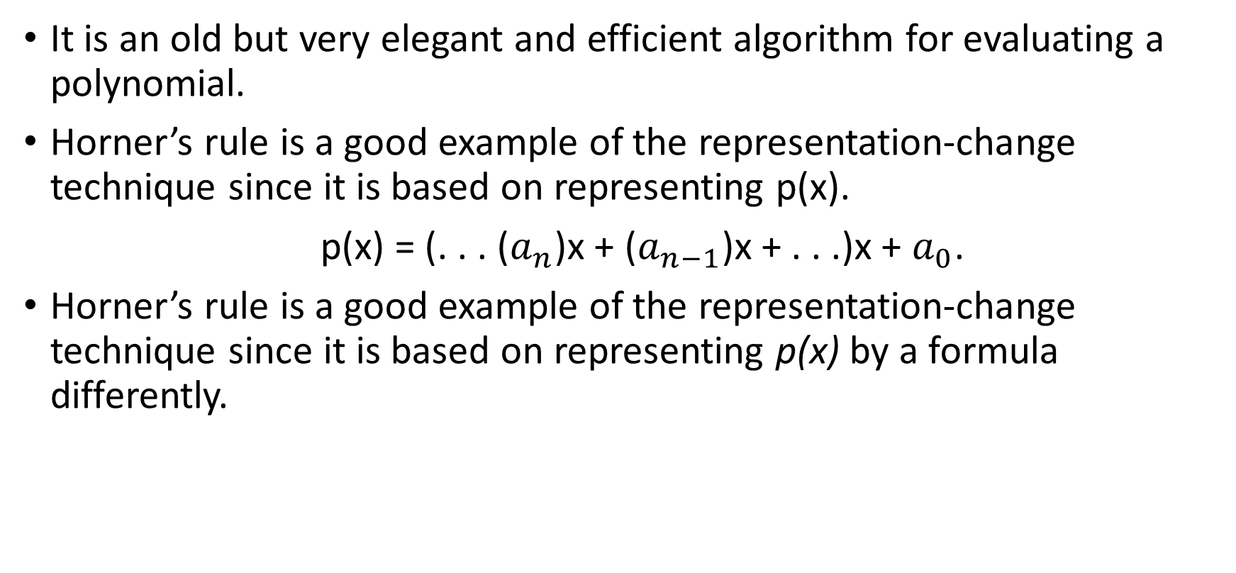
9.0 Horner's Rule
It is an old but very elegant and efficient algorithm for evaluating a polynomial.
Horner’s rule is a good example of the representation-change technique since it is based on representing p(x).
p(x) = (. . . ($a_{n}$)x + ($a_{n−1}$)x + . . .)x + $a_{0}$.
Horner’s rule is a good example of the representation-change technique since it is based on representing p(x) by a formula differently.

Slide 20
9.1 Horner's Rule Algorithm:
ALGORITHM:
Horner(P [0..n], x)
//Evaluates a polynomial at a given point by Horner’s rule
//Input: An array P[0..n] of coefficients of a polynomial of degree n,
// stored from the lowest to the highest and a number x
//Output: The value of the polynomial at x
p←P[n]
for i ←n − 1 downto 0 do
p←x ∗ p + P[i]
return p

Slide 21
9.2Left-Right Binary Exponentiation Algorithm
ALGORITHM LeftRightBinaryExponentiation(a, b(n))
//Computes a^{n} by the left-to-right binary exponentiation algorithm //Input: A number a and a list b(n) of binary digits b_{I} , . . . , b₀
in the binary expansion of a positive integer n
//Output: The value of a^{n} product ← a
for i ← I − 1 downto 0 do product ← product ∗ product if b_{i} = 1 product ← product ∗ a
return product

Slide 22
9.3 Right-Left Binary Exponentiation Algorithm
Algorithm RightLeftBinaryExponent(a, n = b[0...I))
term ← a
if b[0]=1 then product ← a
else product ← 1
for i ← 1 to I do
term**
if b[i] = 1 then product ← product*term
return product

Slide 23
10.0 Problem Reduction
This variation of transform-and-conquer helps to solve a problem by a transforming it into different problems for which an algorithm is already available.
The algorithm to be of practical value, the combined time of the transformation and solving the other problem should be smaller than solving the problem as given by another method.

